Slide 1
Company stock price change forecasting with text mining in financial news
YANG Haobo
20656441

Slide 2
Text mining in financial market
Sentiment analysis allows businesses to identify customer sentiment toward products, brands or services in online conversations and feedback.
Predict movement of stocks in financial social networks with the sentiment of a mass group of expert authors towards various stocks
Predict financial risk based on financial risks
Stock price forecasting by financial sentiment analysis on finance news providers

Slide 3
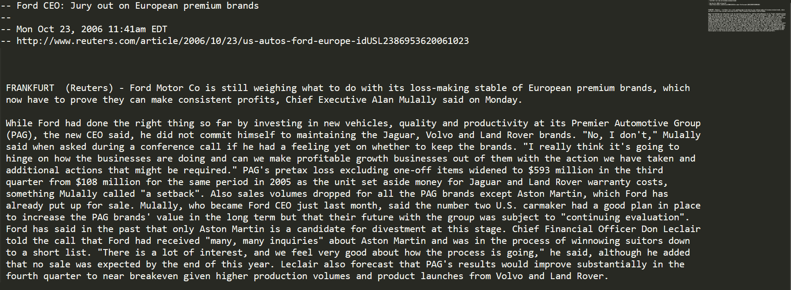
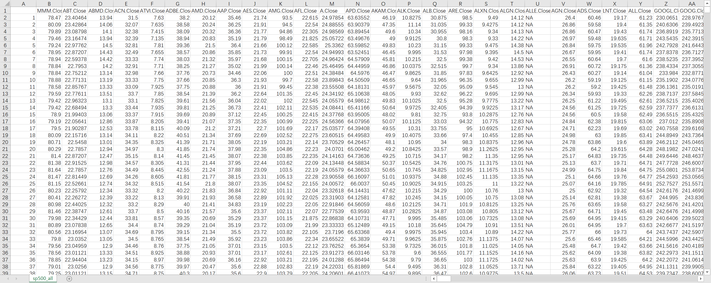
Dataset
106521 Reuters News and historical companies stock price from 20-Oct-08 to 20-Nov-2013

Slide 4

Data cleaning
For text:
Tokenization: Split the text into sentences and the sentences into words. Lowercase the words and remove punctuation.
All stopwords are removed.
Words are lemmatized — words in third person are changed to first person and verbs in past and future tenses are changed into present.
Words are stemmed — words are reduced to their root form.
Same or similar news are removed if jaccard-similarity > 0.8
For stock price percentage change :
zero-mean normalization
Target prediction value: percentage change in current day’s stock price

Slide 5
neural network with TF-IDF measure
TF-IDF indicates the importance of the word
Simple two-layer network:
'This is the first document.’
'This document is the second document.’
'And this is the third one.’
'Is this the first document?'
Layer (type) Output Shape Param # ================================================================= dropout_1 (Dropout) (None, 18193) 0 _________________________________________________________________ dense_1 (Dense) (None, 128) 2078528 _________________________________________________________________ dropout_2 (Dropout) (None, 64) 0 _________________________________________________________________ dense_2 (Dense) (None, 1) 65 ================================================================= Total params: 2,078,593 Trainable params: 2,078,593 Non-trainable params: 0
TfidfVectorizer
[0. 0.46979139 0.58028582 0.38408524 0. 0. 0.38408524 0. 0.38408524]
[0. 0.6876236 0. 0.28108867 0. 0.53864762 0.28108867 0. 0.28108867]
[0.51184851 0. 0. 0.26710379 0.51184851 0. 0.26710379 0.51184851 0.26710379]
[0. 0.46979139 0.58028582 0.38408524 0. 0. 0.38408524 0. 0.38408524]
Accuracy of this model = 55.8%
In our case:
TF-IDF matrix shape: (,18193)

Slide 6
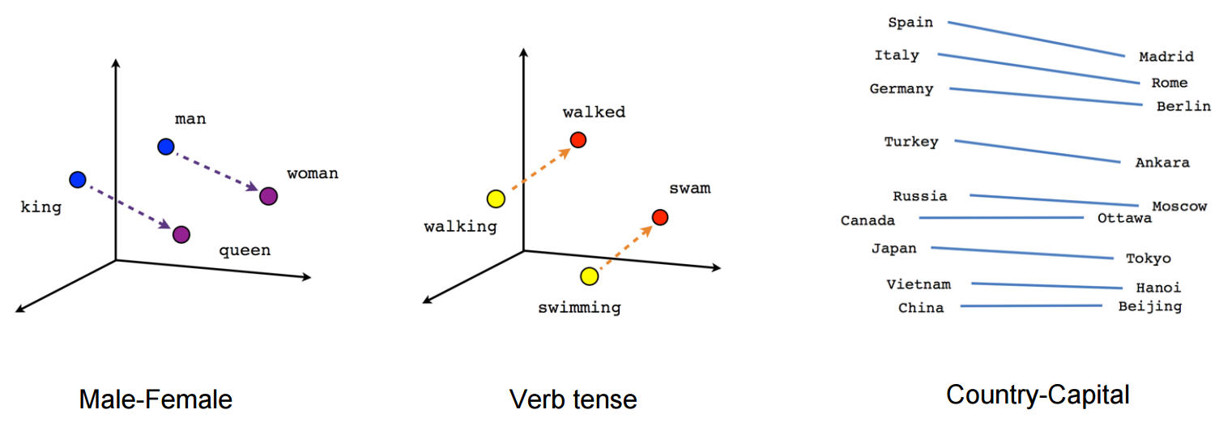
word embedding measure
I
love
study
truly
!
<PAD>
<PAD>
<PAD>
Jeffrey Pennington, Richard Socher, and Christopher D. Manning. 2014. GloVe: Global Vectors for Word Representation

Slide 7
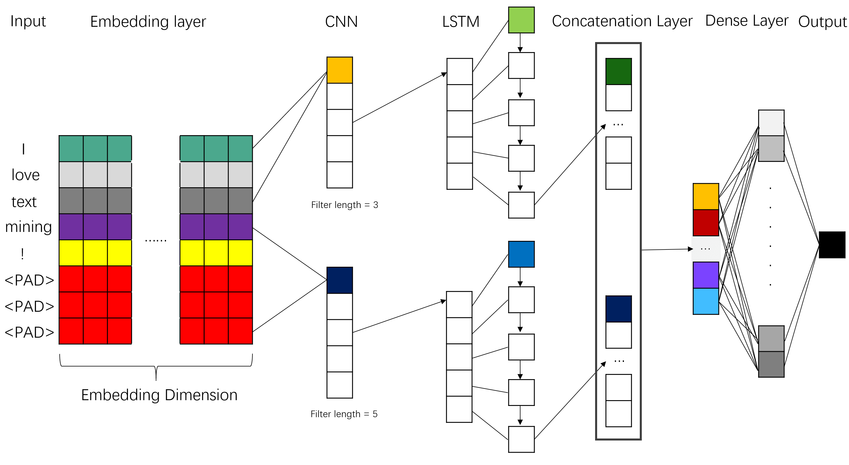
Cnn-lstm network with word embedding
Accuracy of CNN-LSTM model = 0.5799
Model structure:
Layer (type) Output Shape Param # Connected to ================================================================================================== embedding_14_input (InputLayer) (None, 30) 0 __________________________________________________________________________________________________ embedding_15_input (InputLayer) (None, 30) 0 __________________________________________________________________________________________________ embedding_13_input (InputLayer) (None, 30) 0 __________________________________________________________________________________________________ embedding_14 (Embedding) (None, 30, 300) 4821900 embedding_14_input[0][0] __________________________________________________________________________________________________ embedding_15 (Embedding) (None, 30, 300) 4821900 embedding_15_input[0][0] __________________________________________________________________________________________________ embedding_13 (Embedding) (None, 30, 300) 4821900 embedding_13_input[0][0] __________________________________________________________________________________________________ dropout_23 (Dropout) (None, 30, 300) 0 embedding_14[0][0] __________________________________________________________________________________________________ dropout_24 (Dropout) (None, 30, 300) 0 embedding_15[0][0] __________________________________________________________________________________________________ conv1d_13 (Conv1D) (None, 28, 128) 115328 embedding_13[0][0] __________________________________________________________________________________________________ conv1d_14 (Conv1D) (None, 26, 128) 192128 dropout_23[0][0] __________________________________________________________________________________________________ conv1d_15 (Conv1D) (None, 24, 128) 268928 dropout_24[0][0] __________________________________________________________________________________________________ max_pooling1d_13 (MaxPooling1D) (None, 14, 128) 0 conv1d_13[0][0] __________________________________________________________________________________________________ max_pooling1d_14 (MaxPooling1D) (None, 13, 128) 0 conv1d_14[0][0] __________________________________________________________________________________________________ max_pooling1d_15 (MaxPooling1D) (None, 12, 128) 0 conv1d_15[0][0] __________________________________________________________________________________________________ lstm_13 (LSTM) (None, 128) 131584 max_pooling1d_13[0][0] __________________________________________________________________________________________________ lstm_14 (LSTM) (None, 128) 131584 max_pooling1d_14[0][0] __________________________________________________________________________________________________ lstm_15 (LSTM) (None, 128) 131584 max_pooling1d_15[0][0] __________________________________________________________________________________________________ add_5 (Add) (None, 128) 0 lstm_13[0][0] lstm_14[0][0] lstm_15[0][0] __________________________________________________________________________________________________ dense_30 (Dense) (None, 1) 129 add_5[0][0] ================================================================================================== Total params: 15,436,965 Trainable params: 15,436,965 Non-trainable params: 0

Slide 8
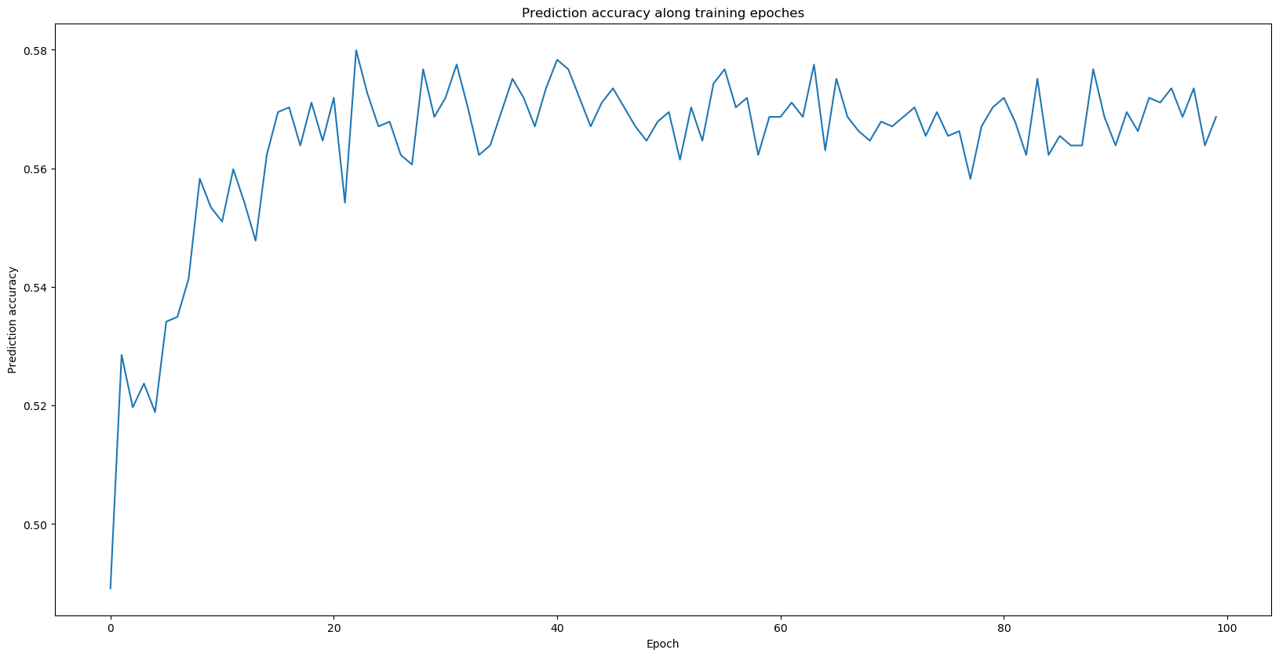
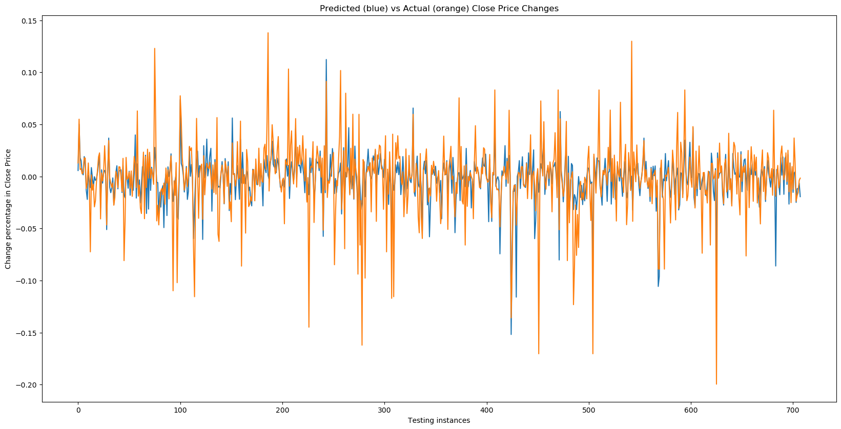
Performance

Slide 9
Further work
Use topic modelling technique like Latent Dirichlet Allocation (LDA) to do pre-process
Topic: 0 Word: 0.005*"inc" + 0.005*"said" + 0.004*"billion" + 0.004*"bank" + 0.004*"corp" + 0.004*"credit" + 0.004*"co" + 0.004*"jpmorgan" + 0.004*"citigroup" + 0.004*"percent" Topic: 1 Word: 0.005*"apple" + 0.005*"inc" + 0.005*"johnson" + 0.005*"said" + 0.005*"stores" + 0.004*"wednesday" + 0.004*"san" + 0.004*"walmart" + 0.004*"tuesday" + 0.004*"executive" Topic: 2 Word: 0.006*"corp" + 0.005*"inc" + 0.005*"billion" + 0.005*"said" + 0.005*"company" + 0.005*"microsoft" + 0.004*"chief" + 0.004*"executive" + 0.004*"co" + 0.004*"jpmorgan" Topic: 3 Word: 0.005*"group" + 0.005*"inc" + 0.005*"goldman" + 0.005*"said" + 0.005*"sachs" + 0.004*"co" + 0.004*"bank" + 0.004*"company" + 0.004*"billion" + 0.003*"million" Topic: 4 Word: 0.007*"bank" + 0.006*"jpmorgan" + 0.006*"goldman" + 0.006*"chase" + 0.006*"sachs" + 0.005*"group" + 0.005*"co" + 0.005*"jpmn" + 0.005*"said" + 0.005*"inc" Topic: 5 Word: 0.006*"corp" + 0.005*"inc" + 0.004*"company" + 0.004*"said" + 0.004*"percent" + 0.004*"bank" + 0.004*"shares" + 0.004*"oil" + 0.003*"investors" + 0.003*"monday" Topic: 6 Word: 0.005*"inc" + 0.005*"apple" + 0.005*"corp" + 0.004*"said" + 0.004*"sales" + 0.004*"percent" + 0.004*"company" + 0.004*"quarterly" + 0.004*"profit" + 0.003*"thursday" Topic: 7 Word: 0.007*"percent" + 0.007*"shares" + 0.006*"quarterly" + 0.005*"inc" + 0.005*"profit" + 0.005*"earnings" + 0.005*"san" + 0.005*"results" + 0.004*"sales" + 0.004*"expectations" Topic: 8 Word: 0.006*"inc" + 0.005*"billion" + 0.005*"said" + 0.004*"goldman" + 0.004*"sachs" + 0.004*"familiar" + 0.004*"group" + 0.004*"bank" + 0.004*"co" + 0.004*"company" Topic: 9 Word: 0.013*"boeing" + 0.010*"ban" + 0.008*"co" + 0.007*"dreamliner" + 0.006*"apple" + 0.005*"aircraft" + 0.005*"said" + 0.004*"new" + 0.004*"jet" + 0.004*"samsung"
Topic 0 is most likely to contain banking companies.
Topic 1 is likely to contains the news about company stores. Topic 7 is likely about the company profits and financial reports.
Topic 9 is mainly about technology companies.

Slide 10
Thank you！
Reference:
Jeffrey Pennington, Richard Socher, and Christopher D. Manning. 2014.
GloVe: Global Vectors for Word Representation
Yoon Kim, 2014
Convolutional Neural Networks for Sentence Classification
M. Day and C. Lee,
"Deep learning for financial sentiment analysis on finance news providers," 2016 IEEE/ACM International Conference on Advances in Social Networks Analysis and Mining (ASONAM), San Francisco, CA, 2016, pp. 1127-1134.

